Slide 1
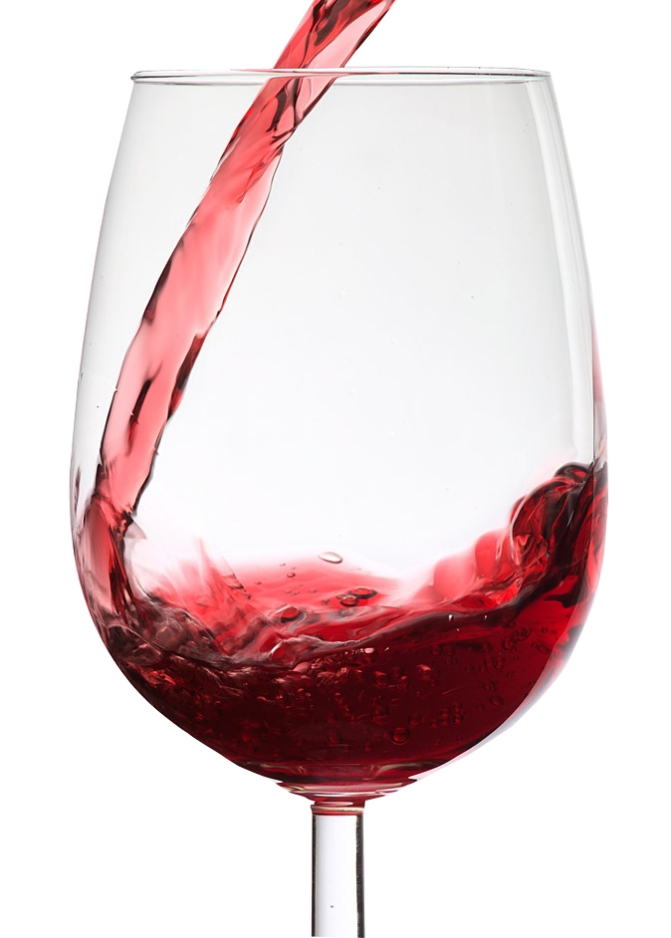
Predicting quality of wine
Done by:
Md irfan khan
Pooja tandle
Pawar arathi
Asha patel

Slide 2

AGENDA
OBJECTIVE
DATA DESCRIPTION
DATA ANALYSIS
CONCLUSION

Slide 3
OBJECTIVE
The dataset contains information about red wine.
The dataset has 1600 data points of each wine with 12 characteristics or attributes.
Wine quality is measured on 3,4,5(low)-6,7,8(high) scale.
Management want
To understand the characteristics of these wines

Slide 4
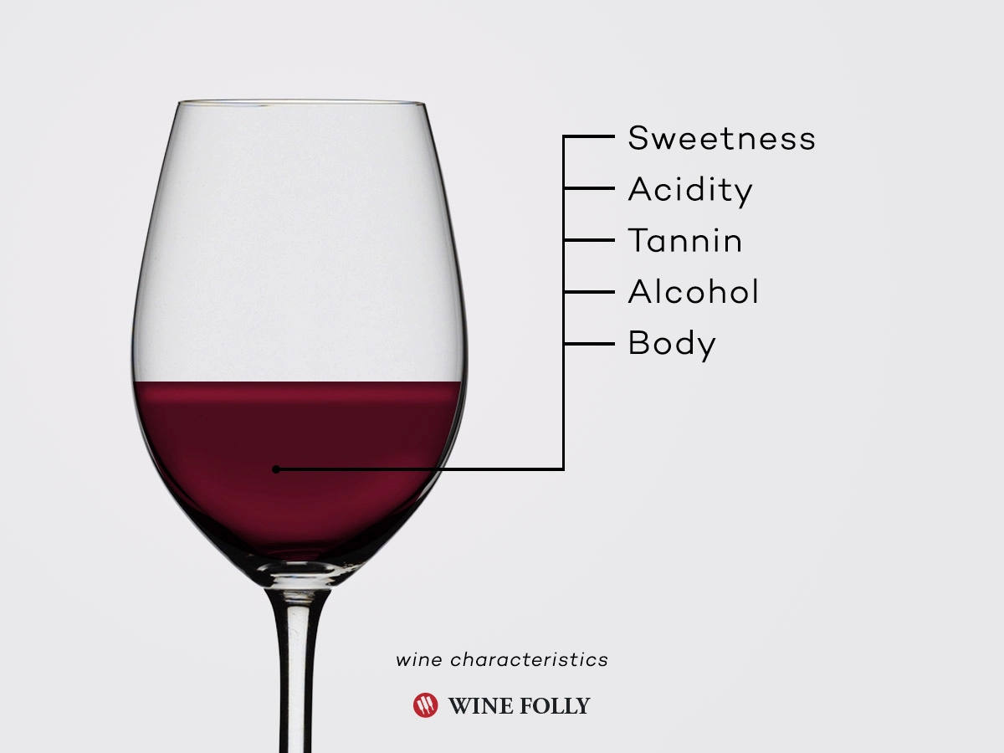
DATA DESCRIPTION
The attributes are as follows
The attributes are as follows
Fixed acidity
Volatile acidity
Citric acid
Residual sugar
Chlorides
Free sulphur dioxide

Slide 5
Total sulphur dioxide
density
pH
sulphates
alcohol
quality

Slide 6
DATA ANALYSIS
To understand the characteristics of the wine and find ingredients contributing more for quality, we have done the following
Subset the data based on wine type and find descriptive statistics.
Subset the data based on good quality(6,7,8,) and bad quality(3,4,5,) and find descriptive statistics.
Decision tree
Subset the data based on good quality1(6,7,8) and bad quality (3,4,5) and found descriptive statistics.

Slide 7
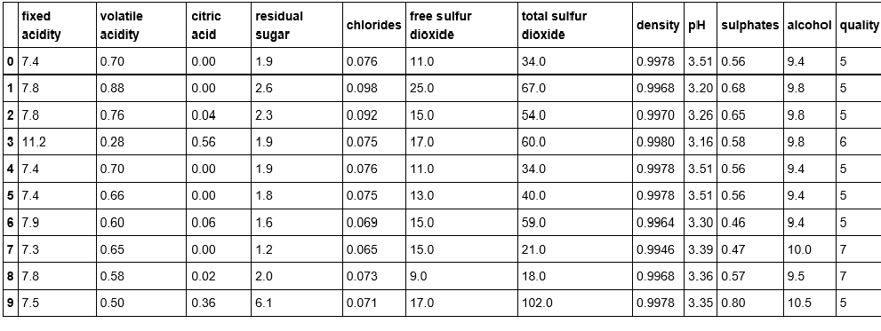

Slide 8
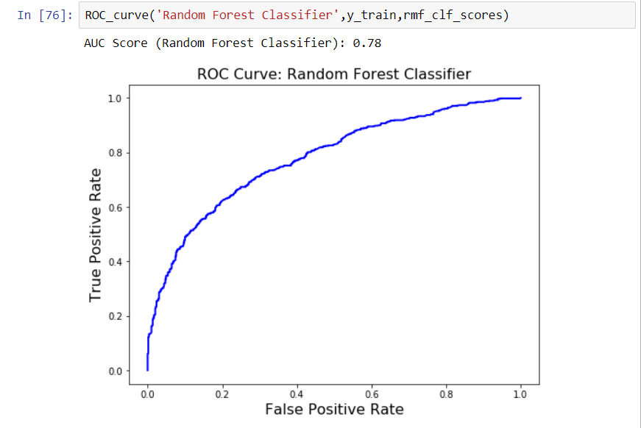
LOGISTIC REGRESSION
Is having the prediction of 0.78 of accuracy
RANDOM FOREST
It also having the prediction of 0.78 of accuracy as comparing to another models

Slide 9
CONCLUSION
Characteristics
Red wine
High or low quality
Ingredients which contribute more for type of the wine.
Chlorides, sulphates, free.sulfur.dioxide, total sulfur dioxide, volatile.acidity , etc.
Ingredients which contribute more for quality of the wine.
Alcohol(major), density.

Slide 10
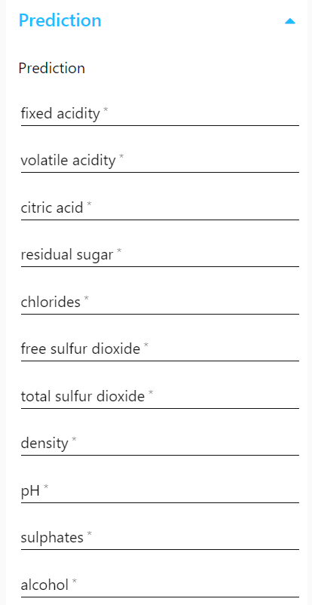

Slide 11


